Slide 1

Business:
Which countries are more ideal to start a business?
Group 5
Olga Shavrina
Sandrine Prevot
Zijing Xue
DAFT NOV 2021: Week 2 project
Notes:
Photo by Carlos Muza on Unsplash

Slide 2
Metadata
Admin:
Table 1: Start-up procedures to register a business
⇒ countries with less procedures: less complicated to start a business
Time:
Table 2: Time required to start a business (days)
⇒ countries with less time required: easier/ quicker to kick off the business
Financial:
Table 3: Cost of business start-up procedures (% of GNI per capita)
⇒ less expensive to start a business
(Size: )
Table 1: New businesses registered (number) by country
⇒ the pure number of new companies, countries with bigger no. of new companies: more attractive
Table 2: New density (new registrations per 1,000 people ages 15-64) by country
⇒ the proportional figures of new companies
Data sources: The World Bank – by wbgapi

Slide 3
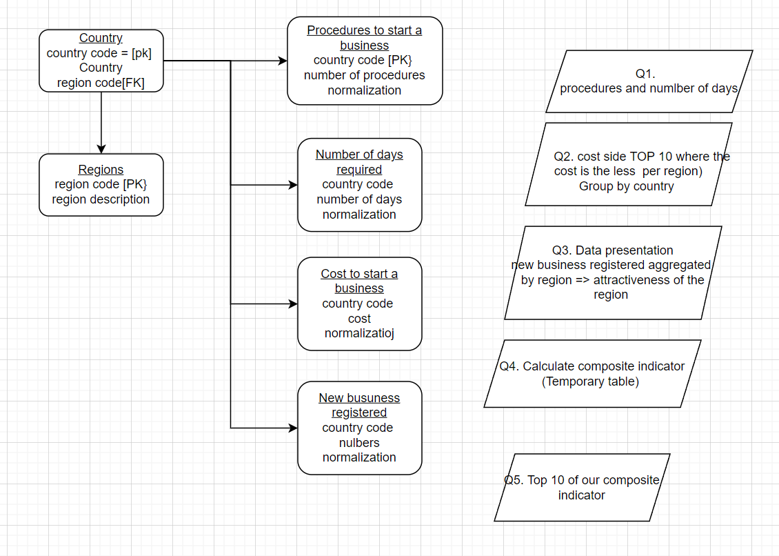
ER Model & Queries

Slide 4
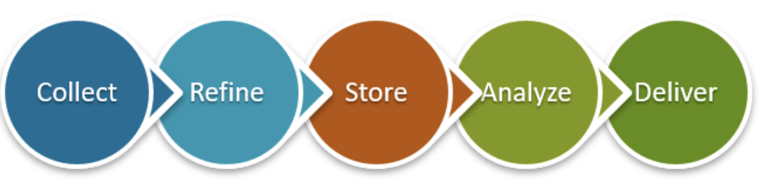
Process, Challenge, Highlight
Process
Challenge
Data Cleaning, Null Data
Transpose tables*
Aggregate all raw data form different tables in a summary table**
Use max and min in sql queries for normalization
Highlight
To see which countries of our classmates & teachers are the best options!
Let’s go ;)
* Annex 1
**Annex 2

Slide 5
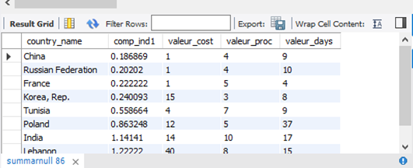
Composite indicator =CI
CI= Starting business facility
Selection of variables:
Cost of business (% per capita) = C
Number of days to start business =D
Number of procedures = P
Nb: We didn’t take in consideration the size, because data are missing for many countries, especially China

Slide 6
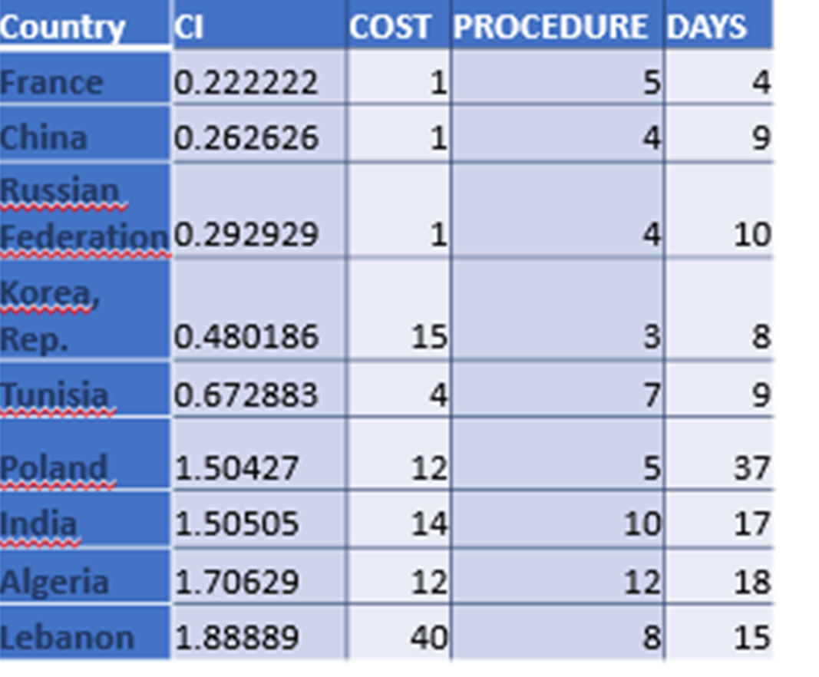
Main Result
Combination of variables :
After normalization of variables (i-min/max-min)
First calculation:
All variables are given the same weight:
CI=C+D+P

Slide 7
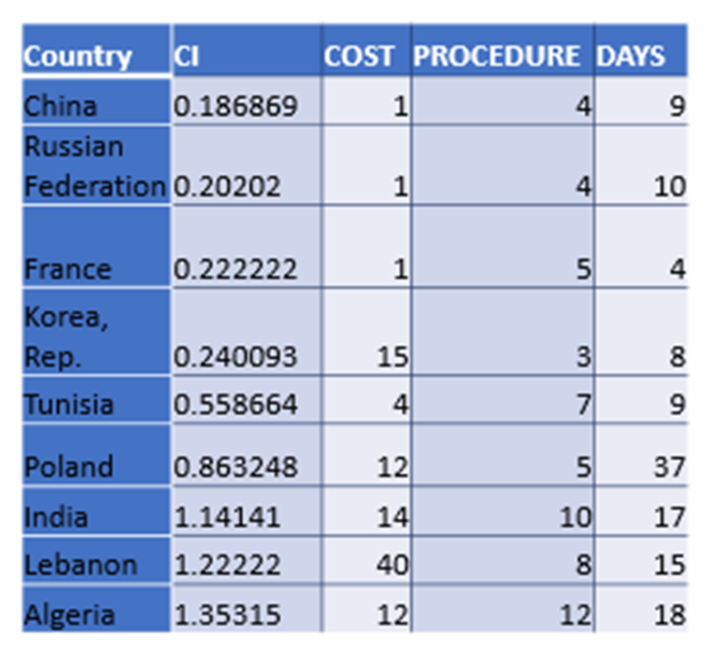
Main Result
Second calculation:
The procedure (P) is considered as more important than the others ones.
CI = C/2 + D/2 + P

Slide 8
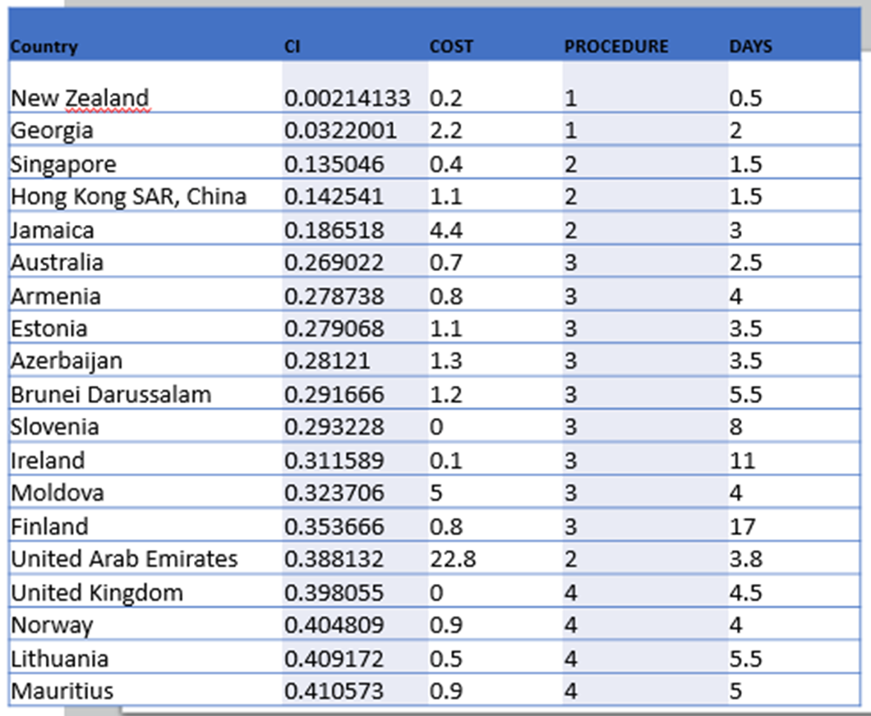
Main Result
Worldwide
(equal weight for C,P,D)

Slide 9
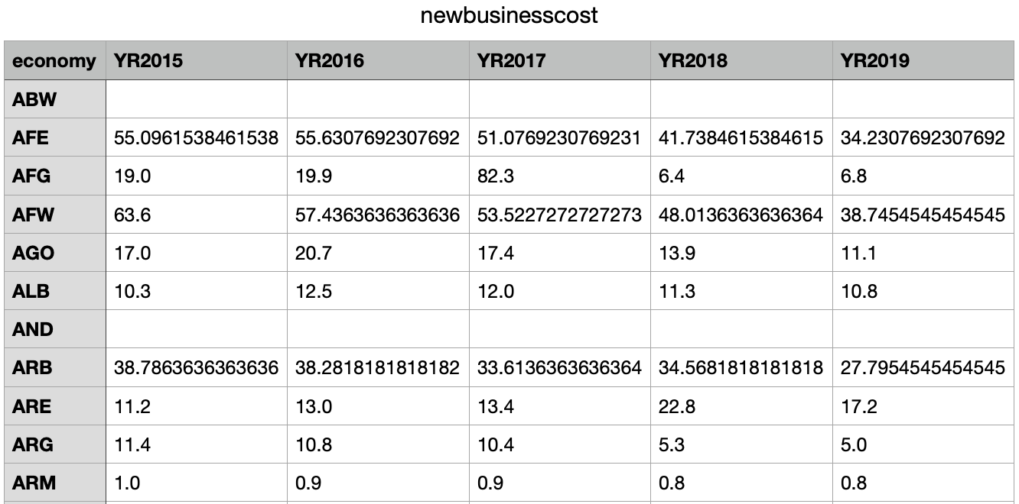
Annex 1: raw csv tables => need to be transposed

Slide 10
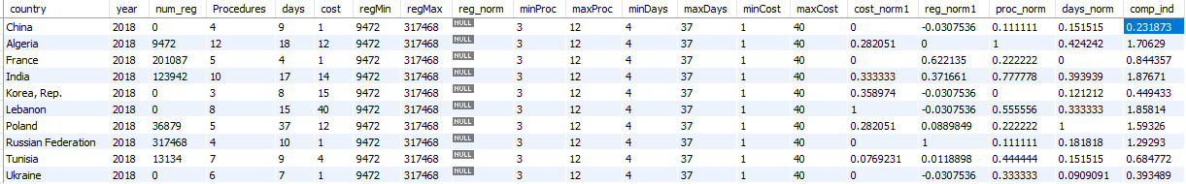
Annex 2: SQL summary table

Slide 11
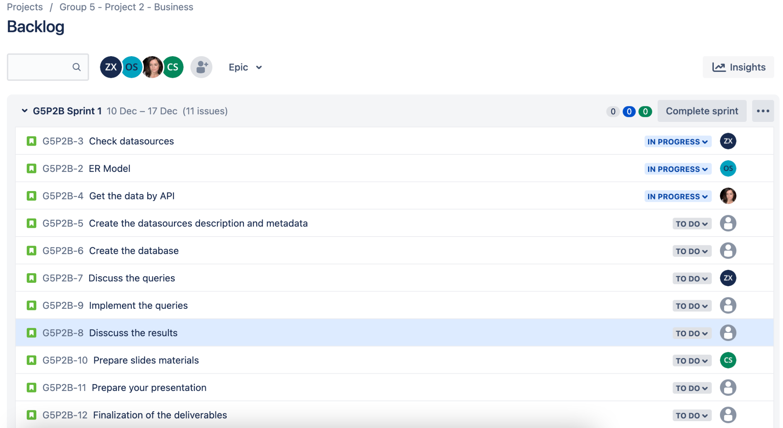
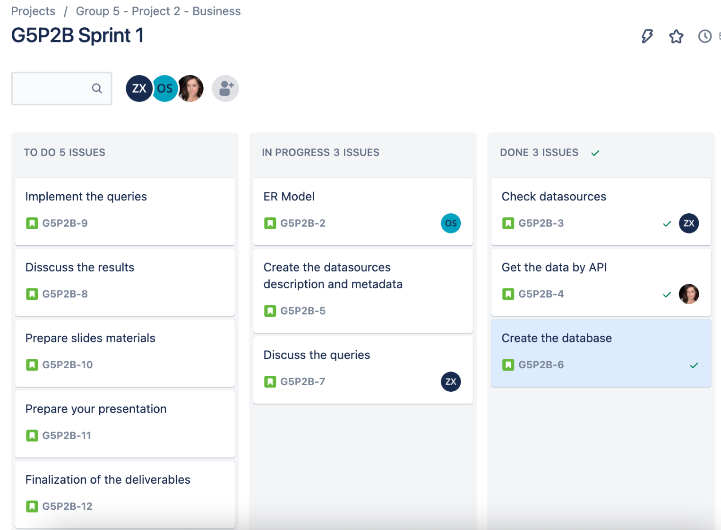
Annex 3: Jira

